Slide 1
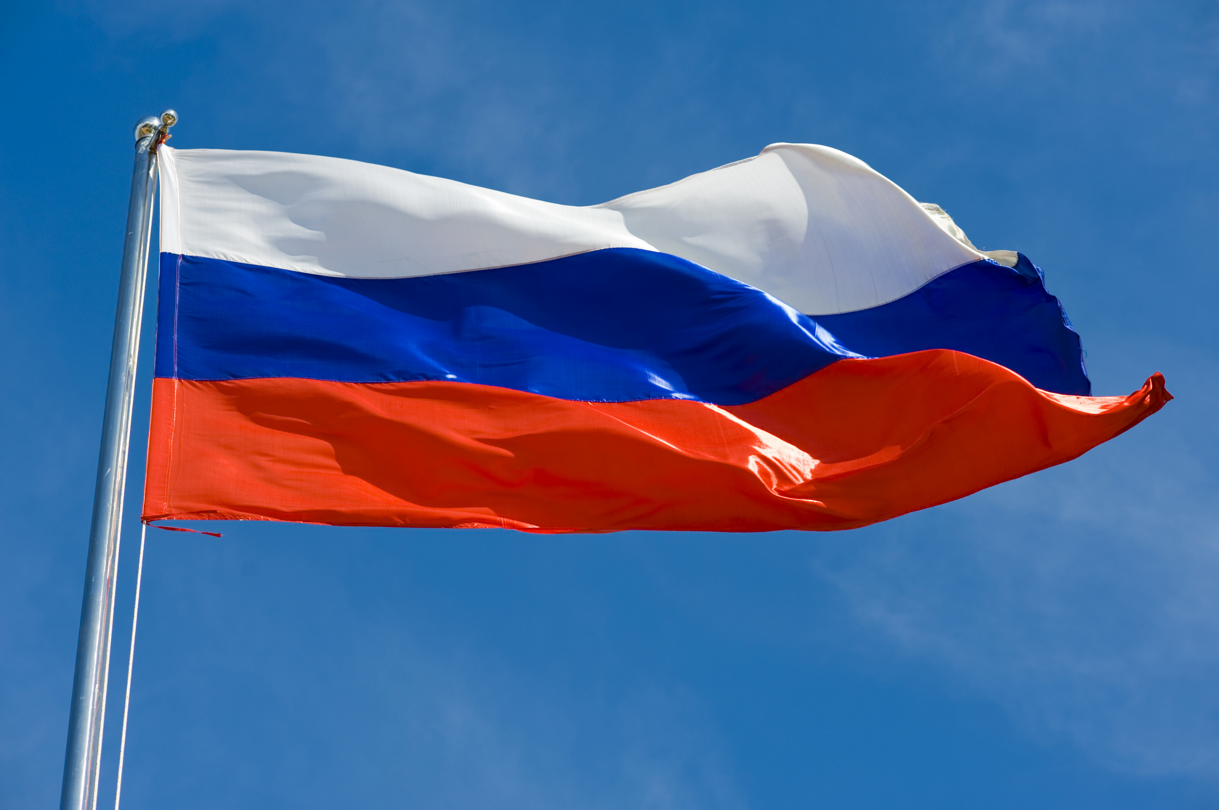
Russia
Ariana and Rayna

Slide 2
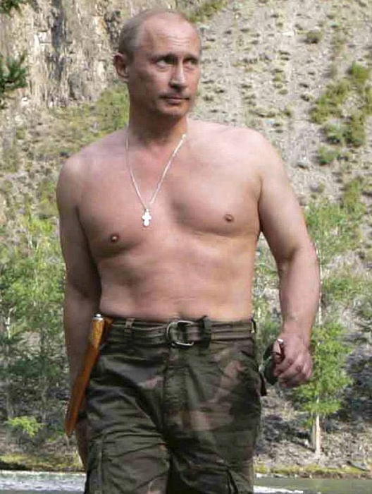
Fast Facts
Official Name: Russian Federation
Form of Government: Semi – Presidential Federation
Capital: Moscow
Population: 142,122, 776
Official Language: Russian
Money: Ruble
Area: 6,592,772

Slide 3
Economy
since the collapse of the Soviet Union, Russia has undergone significant changes, moving from a centrally planned economy to a market-based economy
after a combination of falling oil prices, international sanctions, and structural limitations, Russia was pushed into a deep recession, and reform has stalled in recent years
Russia's heavily dependent on the movement of world commodity prices as reliance on commodity exports makes it more vulnerable to boom and bust cycles that follow the swings in global prices
Russia's GDP in 2017 was $4.016 trillion
In 2017, unemployment rate was 5.2%
13.3% of the population was below the poverty line

Slide 4
Geography
Location:
North Asia bordering the Arctic Ocean extending from Europe to the North Pacific Ocean
approximately 1.8 times the size of the US
largest country in the world in terms of area but unfavorably located in relation to major sea lanes of the world, despite its size, it lacks proper soil and climates for agriculture
13.1% of agricultural land

Slide 5
Government
Russia's history as a democracy is short. The country's first election, in 1917, was quickly reversed by the Bolsheviks, and it wasn't until the 1991 election of Boris Yeltsin that democracy took hold.
Russia is a federation of 86 republics, provinces, territories, and districts, all controlled by the government in Moscow. The head of state is a president elected by the people.
Legal System:
civil law system; judicial review of legislative acts
Executive Branch :
chief of state - President Vladimir Vladimirovich PUTIN (since 7 May 2012)
political parties - 64 political parties are registered with Russia's Ministry of Justice (as of September 2018), but only four parties maintain representation in Russia's national legislature

Slide 6
Energy
one of the world's leading producers of oil and natural gas
number one producer of crude oil
second largest exporter of crude oil
second largest "natural gas" producer

Slide 7
Military and Security
18-27 years old to compulsory or voluntary military service
males are registered for draft at 17 years of age, and have a one -year service obligation
Military Branches:
ground troops
aerospace forces
navy
airborne troops
missile troops

Slide 8
Terrorism
The Caucasus Emirates' aims to establish an Islamic caliphate and end Moscow's rule in the majority-Muslim north Caucasus region
Aum Shinrikyo : aims to attract new members, across Russia, seeking religious guidance and exhibiting a willingness to financially supporting the organization
ISIS: aims to implement its strict interpretation of sharia in Dagestan, Chechnya, Ingushetia, and Kabardino-Balkariya; retaliate for Russian involvement in the Syria conflict

Slide 9
Communications
300 million have phones, 200 million are cell phones
13 National TV broadcasting stations
two state run national radio stations
100 million use internet
Russia has responsibility of a legacy domain of .ru

Slide 10
Transnational Issues
Illicit Drugs:
limited cultivation of illicit cannabis and opium poppy and producer of methamphetamine, mostly for domestic consumption; government has active illicit crop eradication program; used as transshipment point for Asian opiates, cannabis, and Latin
American cocaine bound for growing domestic markets, to a lesser extent Western and Central Europe, and occasionally to the US; major source of heroin precursor chemicals; corruption and organized crime are key concerns; major consumer of opiates
Trafficking in Persons:
Russia is a source, transit, and destination country for men, women, and children who are subjected to forced labor and sex trafficking; with millions of foreign workers, forced labor is Russia’s predominant human trafficking problem and sometimes involves organized crime syndicates; workers from Russia, and other European countries
Disputes:
China and Russia have demarcated the once disputed islands at the Amur and Ussuri confluence and in the Argun River in accordance with the 2004 Agreement, ending their centuries-long border disputes
the sovereignty dispute over the islands of Etorofu, Kunashiri, Shikotan, and the Habomai group, known in Japan as the "Northern Territories" and in Russia as the "Southern Kurils," occupied by the Soviet Union in 1945, now administered by Russia, and claimed by Japan, remains the primary sticking point to signing a peace treaty formally ending World War II hostilities

